Slide 1
PSYC 741 Hierarchical Linear Modeling
Session 1 – Review of linear regression

Slide 2
Overview of Today’s Class
Introduction to the Course
People
Syllabus
Lecture: Linear Regression Review
R
Introduction to R
Linear Regression

Slide 3

Why we are using R in class
Because it is free (yay!!!)
Many MLM-related libraries and functions that are easily accessible
Practice in R is beneficial for data analytic skills more generally

Slide 4
Review of Linear Regression
Multiple linear regression overview
Partial and semi-partial correlations
Sequential linear regression
Linear regression assumptions and diagnostics

Slide 5
Multiple (Linear) Regression Overview
Goal of multiple regression is to see how a group of independent variables predict a single continuous dependent variable.
Combo of variables:
One continuous dependent variable (aka criterion, outcome, Y)
2 or more independent variables (aka predictors, Xs)
Continuous
Dichotomous categorical
3+ level categorical recoded as dummy variables (enter all but one of these)

Slide 6
Multiple Regression: Research Questions
Is a set of IVs significantly associated with the DV?
Is each individual IV significantly associated with the DV, controlling for other IVs?
Is an individual IV (or set of IVs) significantly associated with the DV beyond other IVs?

Slide 7
What regression does (basically)
Through least-squares estimation, generates an equation (including a set of regression coefficients for each X that best predicts Y
What does it mean to “best predict Y”?
Minimize the difference between the predicted (Y’) and actual (Y) values of the DV
Specifically, the smallest sum of the squared deviations between Y’ and Y
This is why you might hear the term ordinary least squares regression
Maximize the correlation between Y’ and Y

Slide 8
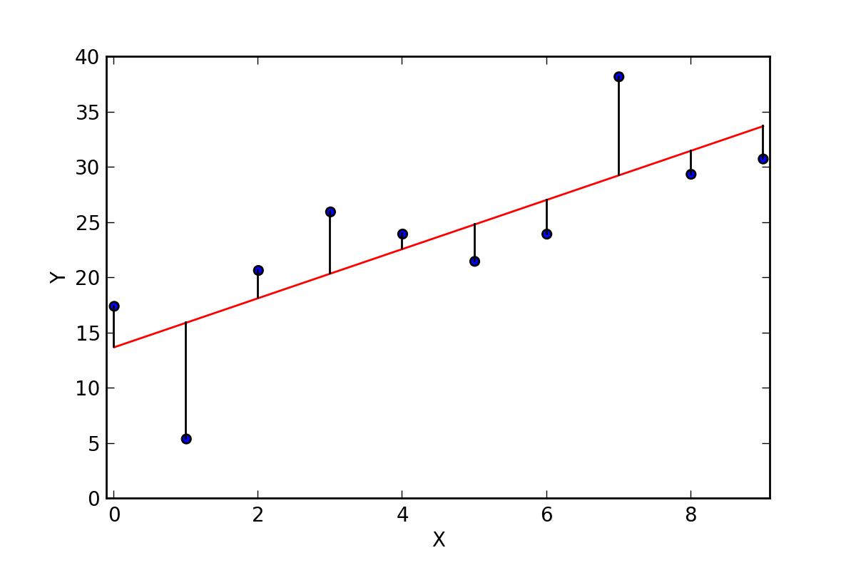
What regression does (basically)

Slide 9
Regression Equation
Y’ = A + B₁X₁ + B₂X₂+ B₃X₃ + … + B_{k}X_{k}
Y’ = a predicted score on the DV
A = intercept/constant
B = regression slope coefficients for each predictor
Sometimes you will see an error/residual (e) term included at the end of the equation, but it is assumed that the mean of this error term is zero

Slide 10
Assessing the Overall Model
Answers the question:
Is a set of IVs significantly associated with the DV?
Key statistics
R²
F
Notes:
Having larger sample size doesn’t necessarily affect R square
But having more predictor does affect R square

Slide 11
All about R²
This is equivalent to the squared correlation between Y’ and Y (simple!)
Also provides information about the percent of variance in Y explained by the set of variables
FYI: This is often seen as an indicator of effect size

Slide 12
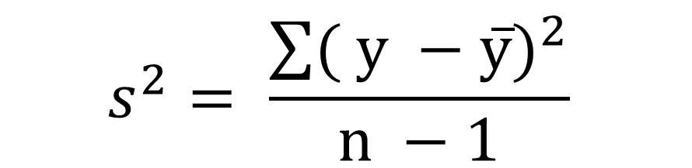
All about Variance
Our regression models predict variance in the DV (Y)
Formula for variance in a sample?
$$s^{2}= \frac{{\sum{( y −y̅})}^{2}}{n −1}$$
Y = observed score on the DV
Y-bar = mean score on the DV
n = sample size

Slide 13
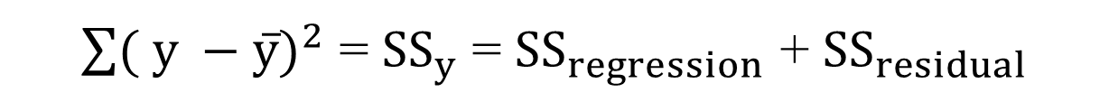
Partitioning variance
Total variance in Y is equal to the sum of …
The variance in Y explained by the regression equation (aka variance explained or regression variance)
The variance NOT explained by the regression equation (aka residual variance or error variance)
Same deal for the Sums of Squares
${\sum{( y −y̅})}^{2}$ = ${SS}_{y}$ = ${SS}_{regression}$ + ${SS}_{residual}$

Slide 14
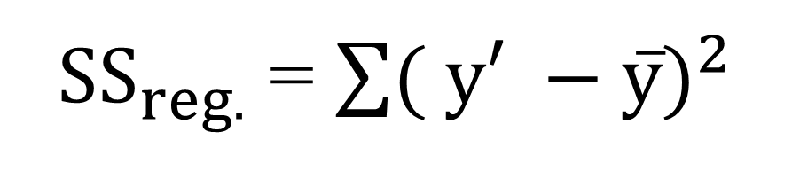
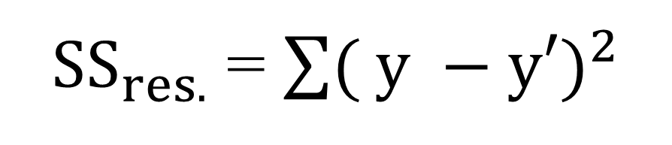
Partitioning variance
SS regression is the sum of the differences of the predicted scores minus the mean, squared
${SS}_{reg.}$ = ${\sum{( y′ −y̅})}^{2}$
SS residual is the sum of the differences of the actual scores minus the predicted scores, squared
${SS}_{res.}$ = ${\sum{( y −y′})}^{2}$

Slide 15
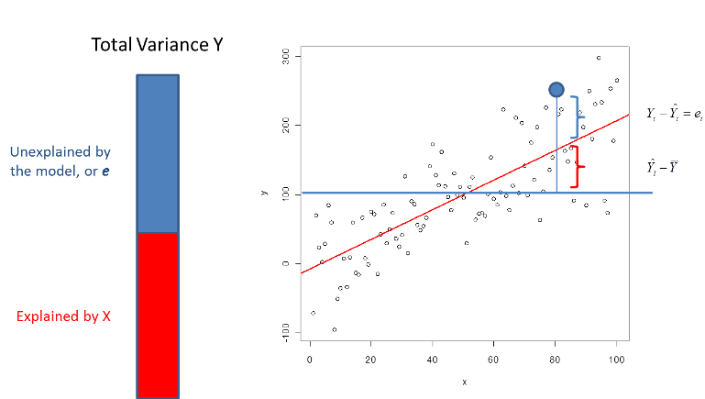
Partitioning variance

Slide 16

Back to R-squared
R² is equal to the SS for the regression divided by the total SS
Interpreted at the percentage of variance explained
Example: R² = .079 means that 7.9% of the variance in the DV was explained by whatever IVs are in the model
$$R^{2}= \frac{{SS}_{reg.}}{{SS}_{y}}$$

Slide 17

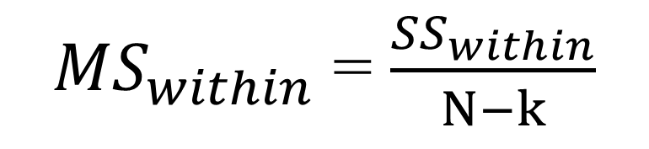
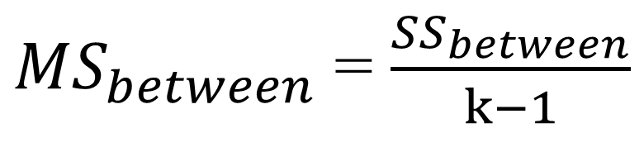
How do we know if R-squared is significant?
F
What is the formula for F for a one-way ANOVA?
${MS}_{between}$ = $\frac{{SS}_{between}}{k−1}$
F = $\frac{{MS}_{between}}{{MS}_{within}}$
${MS}_{within}$ = $\frac{{SS}_{within}}{N−k}$

Slide 18

How do we know if R-squared is significant?
F
F for ANOVA is very similar to F for regression: mean square for the regression divided by the mean square for the residual
dfs:
Regression: k (number of variables)
Residual: N – k – 1
F = $\frac{{MS}_{reg.}}{{MS}_{res.}}=\frac{\left[\frac{{SS}_{reg.}}{k}\right]}{\left[\frac{{SS}_{res.}}{(N−k−1)}\right]}$

Slide 19
Assessing each predictor
Answers the question
Is each individual IV significantly associated with the DV, controlling for other IVs?
Regression equation gives us an unstandardized coefficient (B) for each IV and a constant (A)
Y’ = A + B₁X₁ + B₂X₂+ B₃X₃ + … + B_{k}X_{k}

Slide 20
What A and B’s mean, practically
A (aka the intercept or “Constant”) is equivalent to the predicted value of Y (Y’) when all variables are set to zero
Output will give you a test of whether this is significantly different from zero
(Usually not important… usually not reported in text but sometimes included in table)
Y’ = A + B₁X₁ + B₂X₂+ B₃X₃ + … + B_{k}X_{k}

Slide 21
What A and B’s mean, practically
B (each regression coefficient) is equivalent to the increase in Y associated with a one-unit increase in X … when all of the other predictors are adjusted for
Null hypothesis is that each B = 0
T-tests used to measure significance
Y’ = A + B₁X₁ + B₂X₂+ B₃X₃ + … + B_{k}X_{k}

Slide 22
What A and B’s mean, practically
If IV is a dichotomous variable, then B is the difference in Y between the two groups with all other variables in the model held constant
(because, e.g., the difference in Y between when X₁ = 0 and X₁ = 1 is B₁, all else being equal)
If dummy code, remember that “0” is technically serving as the reference group
Y’ = A + B₁X₁ + B₂X₂+ B₃X₃ + … + B_{k}X_{k}

Slide 23
What about standardized coefficients?
β (betas)
This is the regression weight if both Y and X are standardized
Interpretation: the number of standard deviations that Y would increase with each standard deviation increase in X (with other predictors adjusted for)
When might this be important?

Slide 24
FYI
Effect size for B is not β (but debated)
The squared semi-partial correlation (sr_{i}²) is a better indicator of effect size = % unique variance explained by a given variable
Semi-partial (part) correlation: Relationship between IV with DV after the variance explained in the DV by other IVs is removed
Partial correlation: Relationship between IV with DV after the variance explained in both the IV and the DV by other IVs is removed
Notes:
No"B" in a regression model (representing the unstandardized regression coefficient) is not directly considered an effect size;
however, the standardized version of "B," called "beta" (β), is often used as an effect size measure because it represents the change in the dependent variable for a one standard deviation change in the independent variable

Slide 25
Correlations between predictors
Often said that multiple regression works best if IVs are each correlated with the DV and uncorrelated with each other
In practice, IVs are almost always at least somewhat correlated
This is (usually) OK, but does affect the results
Illustrated with Venn diagrams

Slide 26
Our DV
One circle represents total variance of a DV (Y)
DV

Slide 27
Our DV + 2 uncorrelated IVs
Variance in DV account for by model = a + b
Variance accounted for by IV1 = a
Variance accounted for by IV2 = b
DV
b
IV2
a
IV1

Slide 28
Our DV + 2 correlated IVs
Variance in DV account for by model = a + b + c
Variance accounted for by IV1 = a
Variance accounted for by IV2 = c
This is called unique variance
DV
c
IV2
b
a
IV1

Slide 29
Our DV + 2 correlated IVs
Variance accounted for by both IV1 and IV2 = b
This is called shared (or common) variance
F and R² will reflect a + b + c
B for IV1 will reflect only a, B for IV2 will reflect only c
DV
c
IV2
b
a
IV1

Slide 30
Hierarchical Regression
Answers the question:
Is an individual IV (or set of IVs) significantly associated with the DV beyond other IVs?
IV are entered into the equation either as sets or individual IV in steps
The researcher decides when variables are entered
Could be based on…
Temporality – distal to proximal
“Usual suspects” first and then novel variable(s)
Novel variable first and then “usual suspect” (or demographics or confounders)

Slide 31

Key Statistics
ΔR² = R²_{Step2} - R²_{Step1}
ΔR² = R²_{with} - R²_{without}
ΔR²
(aka R²_{increase} or R²_{inc})
ΔF
(aka F_{increase} or F_{inc})
ΔF = $\frac{\left[\frac{\text{Δ}\text{R}\text{2} }{m}\right]}{\left[\frac{\left(1 − {\text{R}\text{2}}_{with}\right)}{\left(N −k −m − 1\right)}\right]}$
k = # variables in Step 1
m = # of variables added in Step 2
N = total sample size

Slide 32
Assumptions of Multiple Linear Regression
Relationship between all continuous IVs and DV is linear
No univariate and multivariate outliers
Sufficient sample size
No multicollinearity
Residuals OK
Normally distributed; linearly related to DV; homoscedasticity; independent
Notes:
All about residuals

Slide 33
Other issues that I want to mention
Residuals
i.e., Y’ – Y
Should be …
Normally distributed
Have homoscedasticity (standard deviation of residuals should be approx. equal at all levels)
Linearly related to the DV (i.e., no curvilinearity)
Independent from each other (assessed with Durbin Watson statistic)
Notes:
If the assumptions are not met,
The model is biased
The model is predicting well for some people, systematically underpredicting some other people

Slide 34
Next Class
Lecture Topics:
Introduction to Multilevel Modeling
Assumptions of Multilevel Modeling
R
Data wrangling and the tidyverse
Readings that will be discussed
Textbook Chapters 1 and 2
Contributing to your participation grade, make sure to respond to the Readings Feedback/Questions submission on Canvas

Slide 35
Wrapping up
Any questions, comments, concerns??

